Slide 1

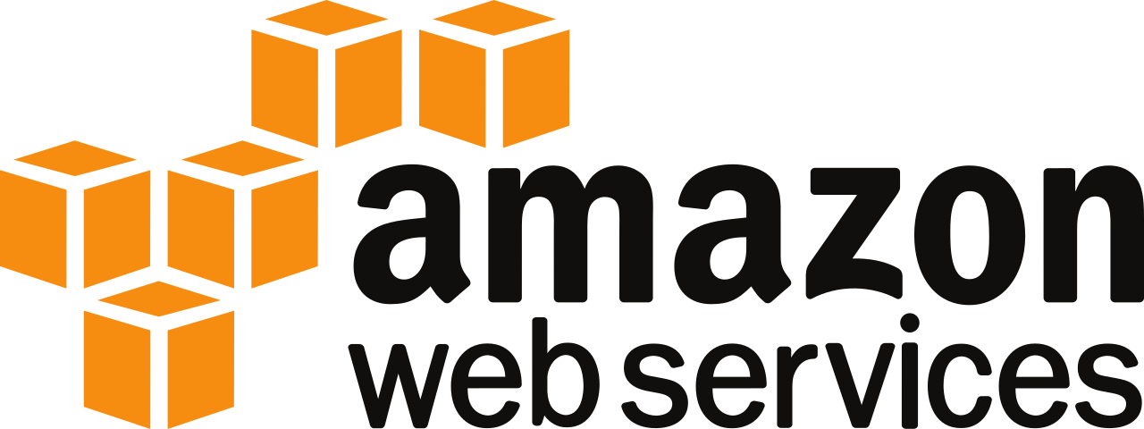
Amazon web services
VPC (VIRTUAL PRIVATE CLOUD)

Slide 2
vpc
A VPC (Virtual Private Cloud) in AWS is like your own private section of the cloud. It’s a space where you can run your resources (like servers) in a safe and controlled environment.

Slide 3
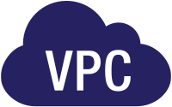
NEED FOR VPC ?
A VPC in AWS is needed to create a secure and private space in the cloud where you can control access, customize your network, and keep your data safe. It lets you manage how your resources interact with the internet and each other.

Slide 4

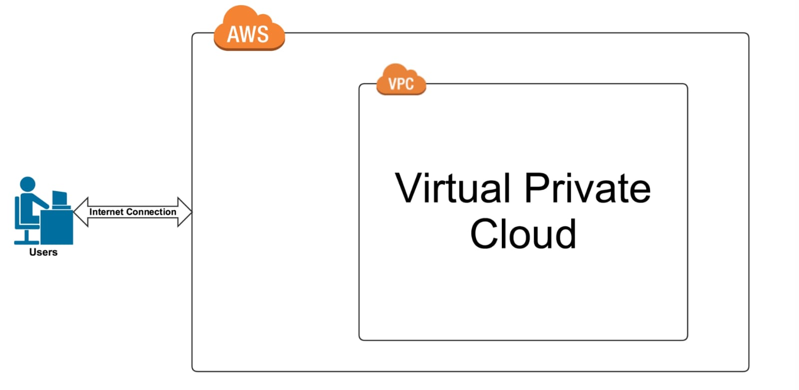
Diagram

Slide 5
Need to remember
Internet Gateway : Internet Gateway is a tool that allows your VPC (Virtual Private Cloud) to connect to the internet.
Route table : route table is a list that helps your network know where to send data.
NACL : NACL (Network ACL) is like a security gate that controls the traffic going in and out of your VPC at the subnet level.
Subnet : subnet is a smaller, isolated section within a VPC where you can place and organize your resources like EC2 instances.
Availability Zones : Availability Zones are separate places in a region that keep your services working even if one place has a problem.

Slide 6

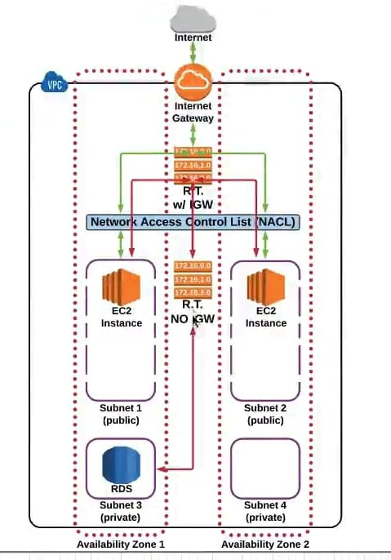

Slide 7


Have a nice day

